Slide 1
Open House
Frau Brudnok

Slide 2
Schedule
6:33-6:43 – Period 1
6:46-6:56 – Period 2
6:59-7:09 – Period 3
7:12-7:22 – Period 4
7:25-7:35 – Period 5
7:38-7:48 – Period 6
7:51-8:01 – Period 7
8:04-8:14 – Period 8
8:17-8:27 – Period 9

Slide 3
AP German
Topics – set by the College Board – focus is language use, not grammar
Global Challenges
Science and Technology
Contemporary Life
Personal and Public Identities
Families and Communitites
Beauty and Aesthetics
Main sites: Blackboard, Google Drive, Quizlet, News Sites, College Board
Available for 3 college credits from LaRoche (can’t take credits from this and the AP test)

Slide 4
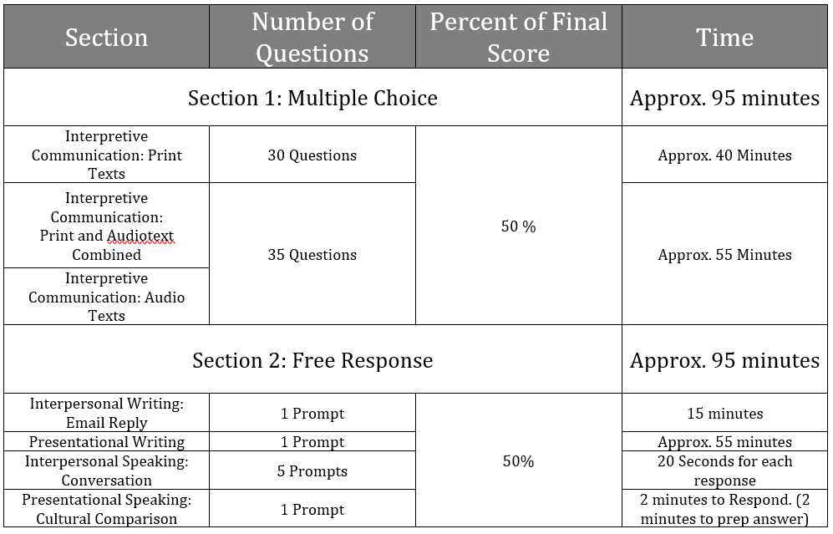
AP Test Format

Slide 5
Honors German 5
Topics
Professions and Careers
Resumes, Cover Letters, discussion plans and dreams
Nature and the Environment
Hypothesizing, Experimenting, and creating solutions
Main sites: Blackboard, VHL Supersite, Google Drive, Quizlet
Available for 3 college credits through LaRoche

Slide 6
Academic/Honors German 4
Topics (Honors does all 4, Academic does 2 now and 2 next year):
Health
City Life
Professions and Careers
Nature and the Environment
Main sites: Blackboard, Google Drive, VHL Supersite, Quizlet
Honors: More speaking, reading, writing, and current events. Honors class can get 3 college credits from LaRoche. Academic students who go on to German 5 and finish the four topics can get the college credit next year.

Slide 7
College Credit Info
Deadlines:
Price: $225
Credit Transfer: https://web2.uconn.edu/ece/credit_transfer_database/index.php
Transcript: getmytranscript.com

Slide 8
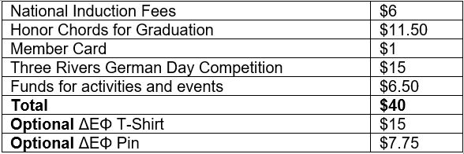
German Club / National German Honors Society
German Club prepares for and competes at Three Rivers German Day
drawing, painting, posters, construction models, poetry writing, poetry recitation, fiction writing, nonfiction writing, quiz bowl, technology, music, and skit
NGHS
3.6 German GPA past three semesters (unweighted)
3.0 GPA overall (unweighted)
10 service hours/culture activities and competes at Three Rivers German Day
Seniors that missed induction in the spring because of remote learning can be inducted in the fall this year
Other juniors and seniors can be inducted in the spring

